Slide 1


MENTAL HEALTH
VS
MUSIC
ML PROJECT

Slide 2

CONTENT
03
01
INTRODUCTION
02
THE PROBLEM
HOW WE SOLVED IT?
04
INSIGHTS
05
LIMITATIONS
06
RECOMMENDATIONS

Slide 3


INTRODUCTION
In the context of today’s mental health prevalence, we did a project to explore the effect of music on mental health.
Notes:
Music has been an integral part of human culture for centuries, serving as a universal language that transcends boundaries and connects people on a profound emotional level. Beyond its artistic and entertainment value, emerging research suggests that music has a powerful impact on mental health. This intersection between music and mental well-being has become a focal point of interest in various fields, including psychology, neuroscience, and now, machine learning. In recent years, advances in machine learning have opened new avenues for exploring and understanding the intricate relationship between music and mental health. This project seeks to delve into this dynamic interplay, leveraging the capabilities of machine learning algorithms to analyze vast datasets of musical compositions, individual preferences, and psychological responses.

Slide 4


OUR QUESTION?
Can music play a role in addressing mental health challenges?
From this
To this

Slide 5
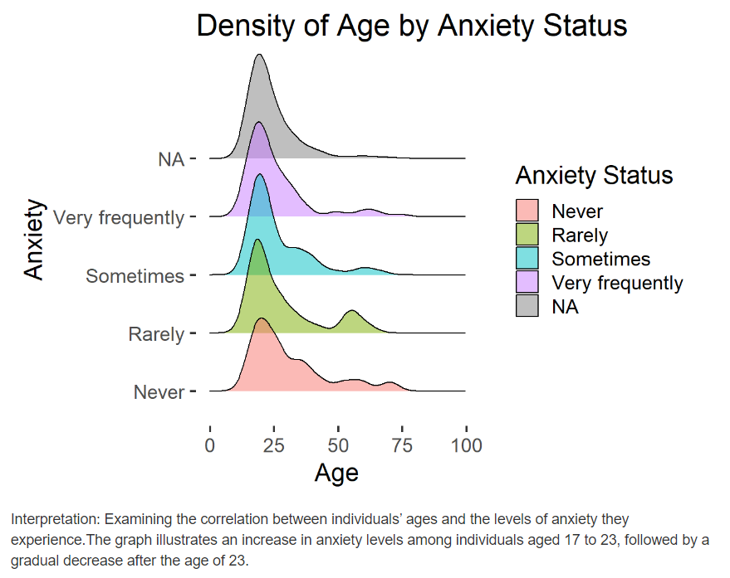
Notes:
We can declare that

Slide 6
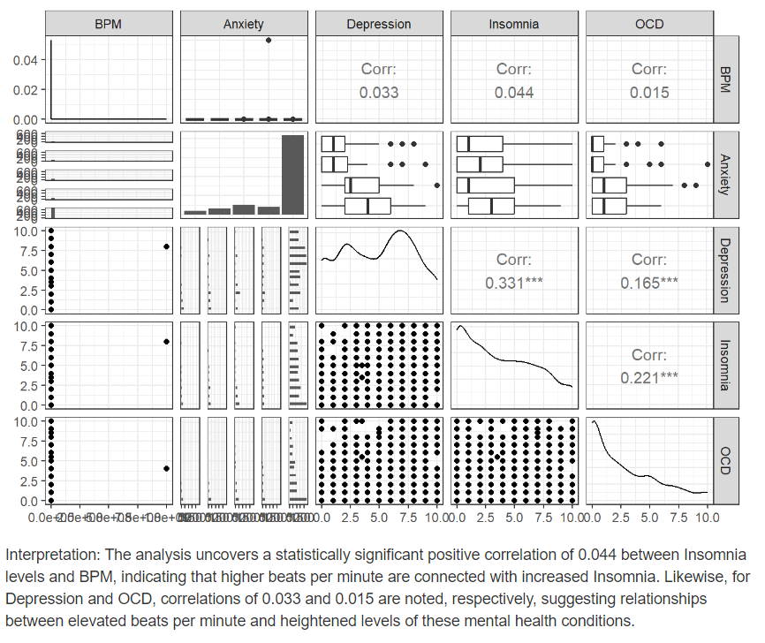
Notes:
We can see that

Slide 7
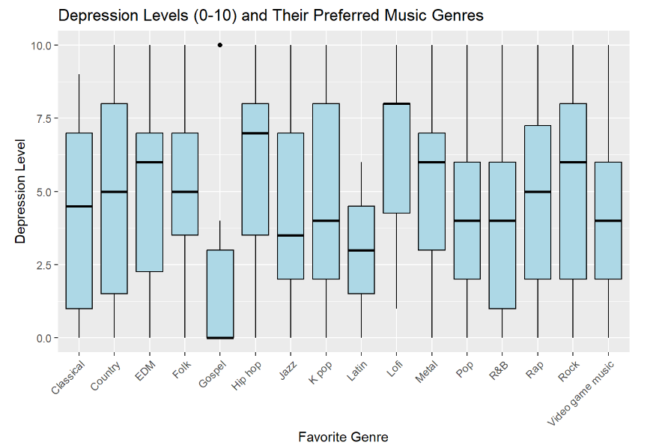
Notes:
We can conclude that Rock, Hip hop, Lofi inflates depression and Gospel, Latin alleviates depression and makes us feel calm.

Slide 8
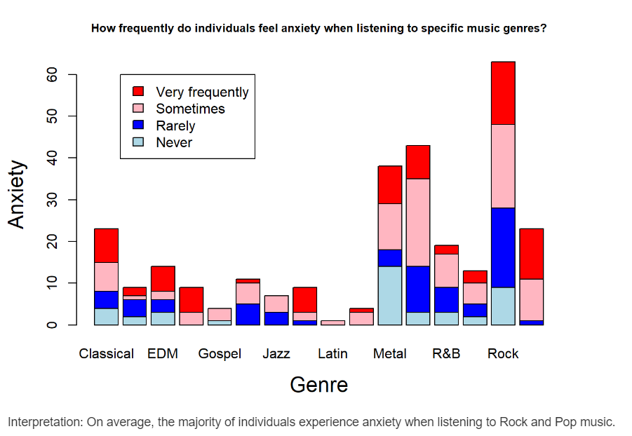
Notes:
We can say that Rock, Pop, Metal – experience high levels of anxiety

Slide 9





HOW WE SOLVED IT?
RANDOM FOREST
BAGGING MODEL
XGBOOST
Notes:
As we move on to the next slide, we would like to give a special mention to our laptop, that also struggled to help us solve this!!
Random forest: it involves building multiple decision trees on subsets. The final prediction is a combination of the predictions made by individual trees through majority voting or averaging.
Bagging model: random subsets of training data are sampled and multiple instances of base model are trained on these subsets individually. The final prediction is often determined by combining the predictions of individual models through voting or averaging.
Xgboost: it builds a series of weak learners or trees sequentially, with each tree correcting the errors of it’s predecessor. It works really well for categorical variables.

Slide 10
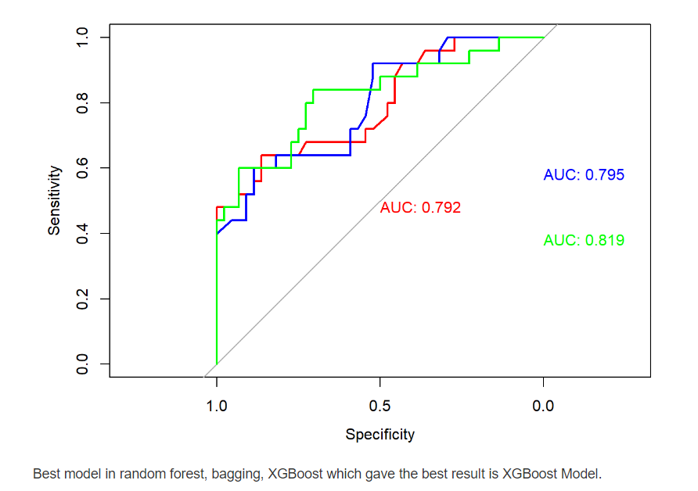
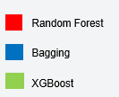

Slide 11
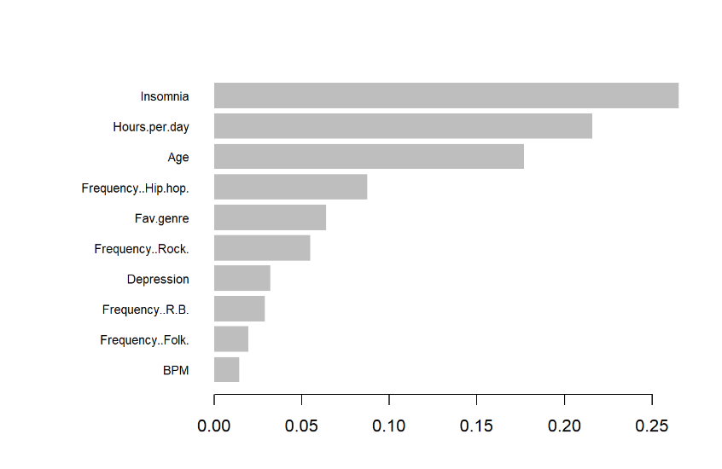
Variable Importance Chart
Notes:
Insomnia" being the most important feature suggests that it has the strongest relationship with the target variable compared to the other features in the model. This means changes in the "Insomnia" variable are likely to result in significant changes in the prediction outcome of the model.
"Insomnia" could be a predictor for various health issues.

Slide 12
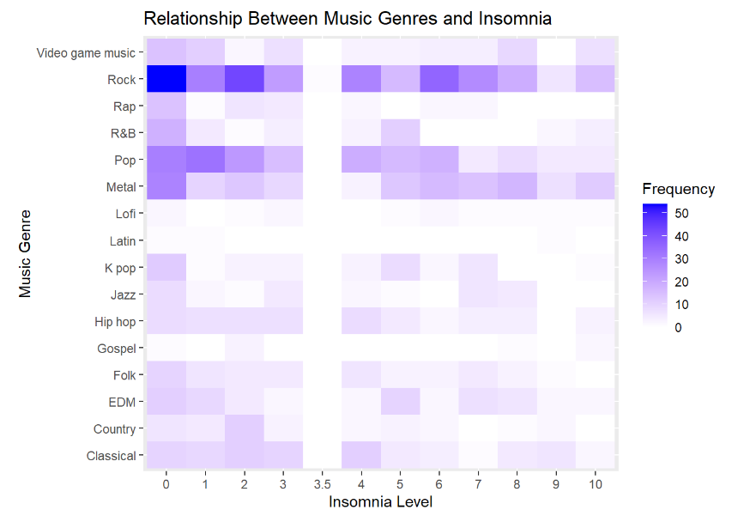
Notes:
it appears that listening to rock music has a more pronounced association with varying levels of insomnia, which in turn is a significant indicator of mental health. Following rock music, the genres of metal and pop also show a connection with insomnia, albeit to a lesser extent. This pattern suggests that these music genres may have differing levels of influence on sleep patterns, which could be reflective of their impact on mental well-being.

Slide 13
LIMITATIONS
Limited Access to Personal Data
Data Bias
Handling Sensitive Information
Cultural Variations
Personal Music Preferences
Notes:
Limited Access to Personal Data: Due to privacy concerns, obtaining detailed and personalized data on individuals' mental health and their music preferences can be challenging.
Data Bias: The available data might not be representative of all geographical regions, leading to biased outcomes.
Handling Sensitive Information: Mental health data is highly sensitive. Ensuring privacy and ethical use of this data is crucial.
Cultural Variations: Musical preferences and their impact on mental health can vary widely across different cultures.
Personal Music Preferences: Some people can have their own music choices that can affect our outcome analysis due to bias.

Slide 14

RECOMMENDATION
Cultivating a diverse musical playlist is encouraged for a well-rounded experience.
Excessive exposure to intense genres like rock music may have potential implications for mental well-being.
We suggest embracing a balanced musical selection and remaining mindful of individual emotional responses to various genres.

